Slide 1

Final REVIEW
GAN HYPER RESOLUTION
Homepage: https://github.com/AIDL-PROJ-2022/enhanced-srgan

Slide 2




















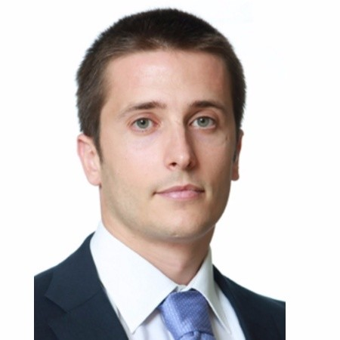
SOP
Motor Combustión
EOP
VS11 CCGW
1. Motivation of the project
7. Loss functions
2. Introduction to SR
8. Training Process
REVIEW
3. Milestones
9. Hyperparameters
FINAL
r
4. Dataset used
10. Quality metrics
5. Environment
11. Results
6. Model Definition
12. Conclusions
SOP
Coche Eléctrico
PROJECT ADVISOR:
DANI FOJO
GAN HYPER RESOLUTION PROJECT
MARC BERMEJO
RAUL PUENTE
FERRAN TORRES
Notes:
Expected Contents
Motivation of the project: Why did you choose this one ?
Goals: What do you want to achieve at the end ? Define at least four of them. Your grades will depend on their difficulty & whether you level of achievement.
Implementation: Which deep learning framework ? Which computational resources ? Which data ?
Milestones: Define at least three intermediate milestones.
Project plan: Gantt chart with planned milestones.
Progress: Report your progress up to date.
Your questions: Pose your questions to the panel of advisors.

Slide 3

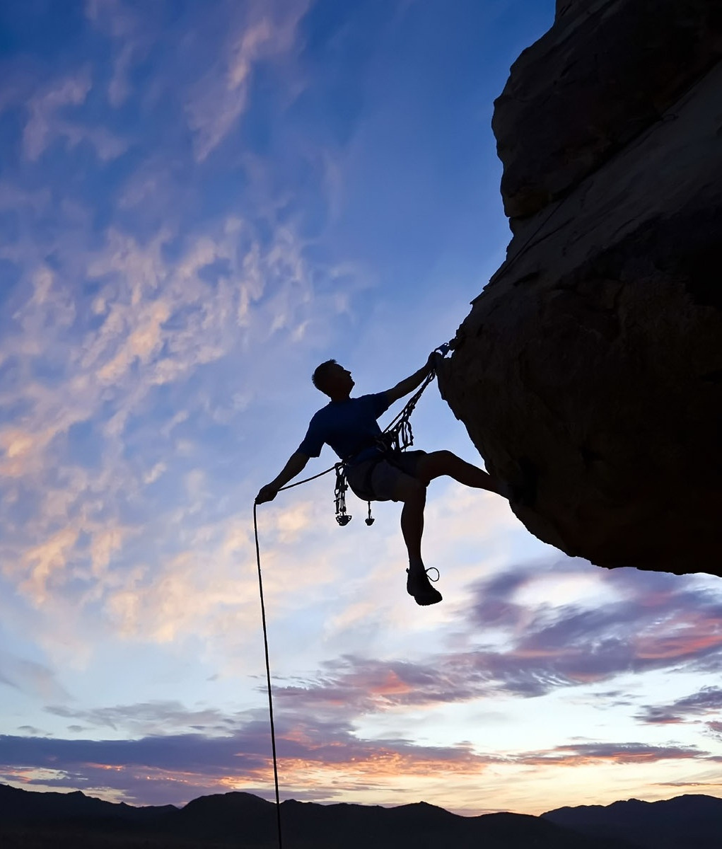






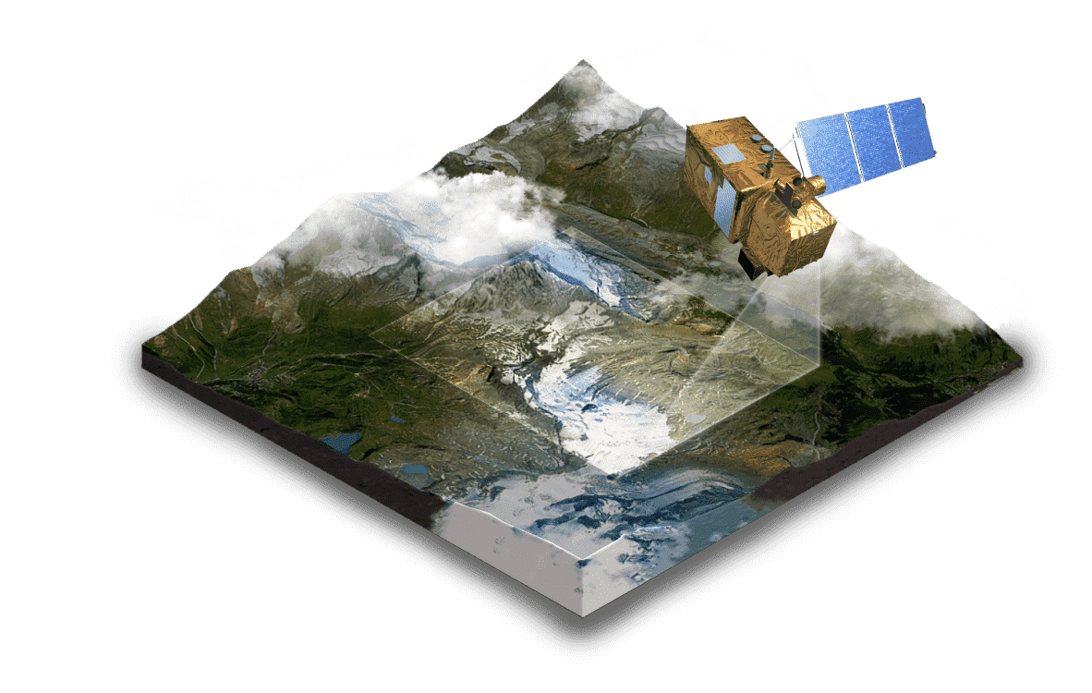

SOP
Motor Combustión
EOP
VS11 CCGW
MOTIVATION
Super Resolution and its application
OF THE
PROJECT
Deeper understanding of GANs
Solution at business level
Industrialización
concepto
SOP
Coche Eléctrico
PROJECT ADVISOR:
DANI FOJO
GAN HYPER RESOLUTION PROJECT
MARC BERMEJO
RAUL PUENTE
FERRAN TORRES
Notes:
Text
The aim of choosing a project based on Super Resolution was to investigate this set of techniques because of the wide range of possible solutions to real challenges that they can provide. Some examples could be the resolution improvement of images coming from satellites for future analysis or the enhancement of optical inspection processes used in many sectors like Aerospace, Electronics or FMCG.
Following our project advisor’s recommendations, the team decided to follow the GAN model run the implementation, which represented a great opportunity to learn more about this kind architectures. Training a GAN network is a nice challenge given the complexity of having to train 2 different networks competing with each to outperform and fool the system.
As mentioned previously, the idea of the project was to target a solution with potential appliance at business level.
Pictures:
AOI Image: https://industry40.co.in/automated-visual-quality-inspection-using-ai-ml-in-manufacturing/
Satellite Image: https://eos.com/products/landviewer/
Example:
https://www.sipotek.net/wide-range-of-automated-visual-inspection-systems-working-by-high-resolution-and-high-speed-industrial-machine-vision-camera-system/

Slide 4



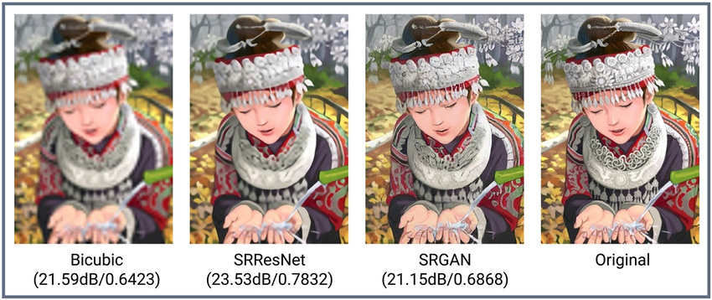

ESRGAN
EOP
VS11 CCGW
INTRODUCTION
5
TO
SUPER
RESOLUTION
4
3
SRGAN
2
ResNet
1
SRCNN
“The estimation of a high-resolution (HR) image from a single low-resolution (LR) counterpart is referred to as super-resolution (SR).”
Interpolation
PROJECT ADVISOR:
DANI FOJO
GAN HYPER RESOLUTION PROJECT
MARC BERMEJO
RAUL PUENTE
FERRAN TORRES
Notes:
Text
The first methods that targeted an increase the resolution of an image, where based on different possible interpolation methods estimating values of the unknown pixels using the ones at their surroundings.
Later on, the introduction of Convolutional neural networks using a Classifier and the feature extractor allowed first image-to-image mapping model for Super Resolution, the SRCNN.
Afterwards, the SRCNN inspired the creation of new architectures that included different updates and improved accuracy:
Resnet: use of skip connections.
Replacement of simple convolutions by residual blocks
Learnable Upsampling methods like Sub-Pixel convolution instead of interpolations..
Some time later, the introduction of the Perceptual loss, which is a mean of all MSE of each pixel (Target Real HR Image VS Output), as Loss function instead of using directly the MSE error proved to be a right choice as it reduced over-smoothing improving the perceptual quality.
And finally the transition to GANs with:
A Generator based on Resnet and Sub-Pixel Convolution that learns to create SR images and combines Perceptual Loss and Adversarial Loss inside its loss function.
A Discriminator that learns to identify if an image is real or Fake.
Info Sources:
https://towardsdatascience.com/an-evolution-in-single-image-super-resolution-using-deep-learning-66f0adfb2d6b
https://www.synopsys.com/designware-ip/technical-bulletin/super-resolution-with-arc-ev.html
Pictures:
https://zzutk.github.io/SRNTT-Project-Page/

Slide 5










Project
Preparation
(100%)
First Model
Training
(100%)
Final project
Review & conclusions
(100%)
SOP
Motor Combustión
EOP
VS11 CCGW
PROJECT
MILESTONES
11/05
24/05
12/06
19/06
10/07
Dataset
Preparation & Loading
(100%)
First metrics
of model training
(100%)
Industrialización
concepto
SOP
Coche Eléctrico
PROJECT ADVISOR:
DANI FOJO
GAN HYPER RESOLUTION PROJECT
MARC BERMEJO
RAUL PUENTE
FERRAN TORRES
Notes:
Milestone M1 - 11/05: Project preparation completed (100%)
Milestone M2 - 24/05: Dataset preparation and loading ready (90%)
Milestone M3 - 12/05: First model training (0%)
Milestone M4 - 19/06: Visualize first metrics of model training (0%)
Milestone M5 - 10/07: Final project review and conclusions (0%)

Slide 6
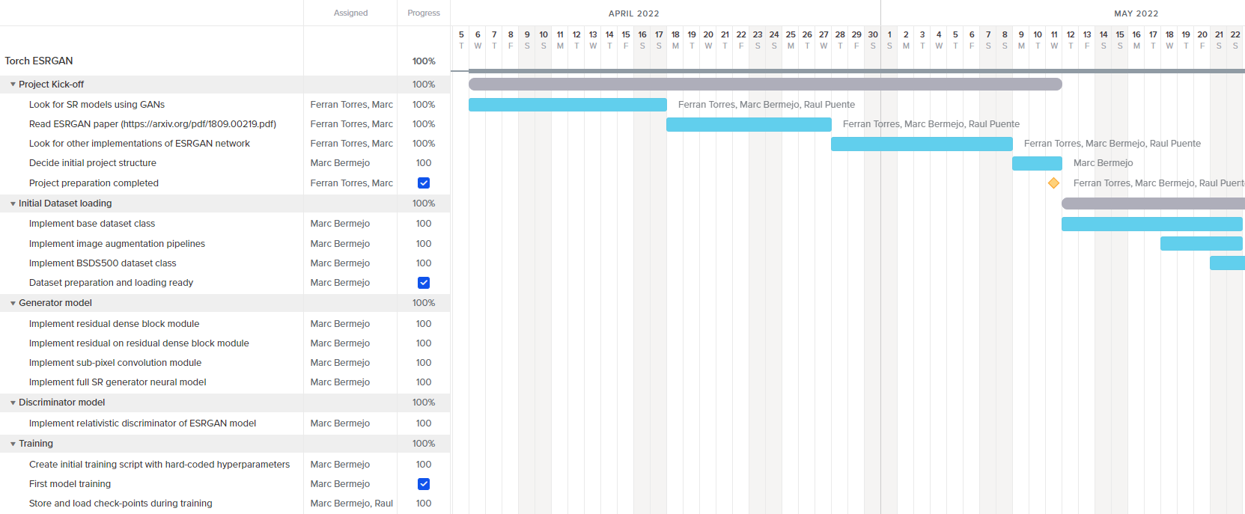
PROJECT
MILESTONES
PROJECT ADVISOR:
DANI FOJO
GAN HYPER RESOLUTION PROJECT
MARC BERMEJO
RAUL PUENTE
FERRAN TORRES
Notes:
Milestone M1 - 11/05: Project preparation completed (100%)
Milestone M2 - 24/05: Dataset preparation and loading ready (90%)
Milestone M3 - 12/05: First model training (0%)
Milestone M4 - 19/06: Visualize first metrics of model training (0%)
Milestone M5 - 10/07: Final project review and conclusions (0%)

Slide 7
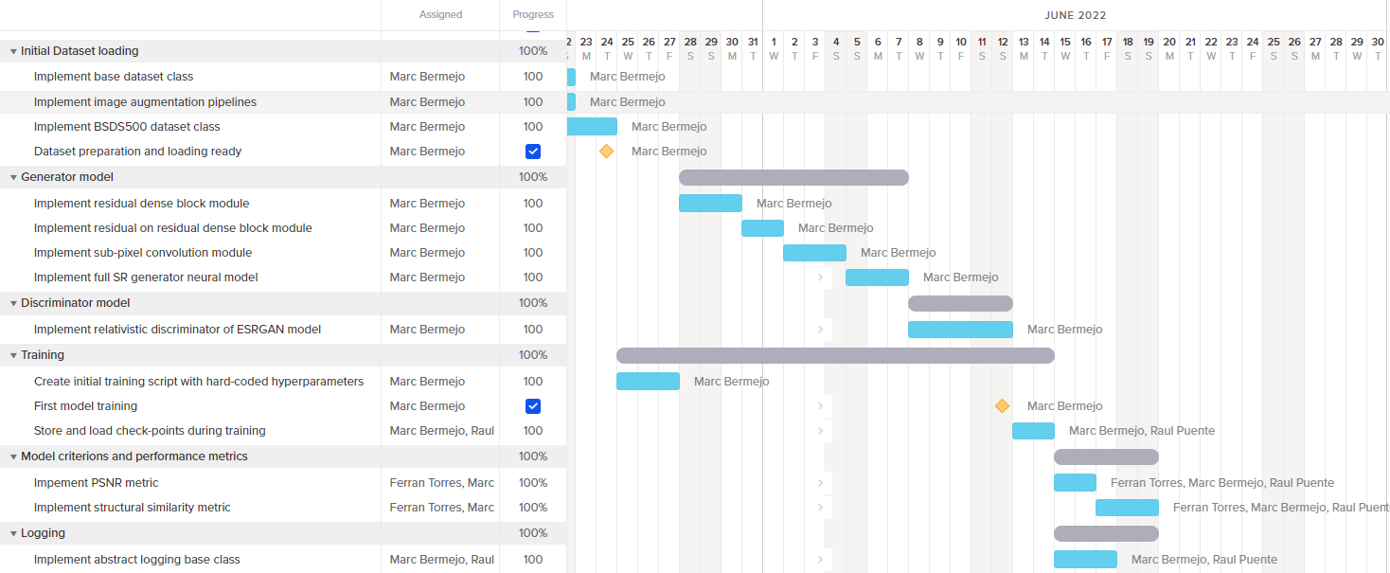
PROJECT
MILESTONES
GANTT
PROJECT ADVISOR:
DANI FOJO
GAN HYPER RESOLUTION PROJECT
MARC BERMEJO
RAUL PUENTE
FERRAN TORRES
Notes:
Milestone M1 - 11/05: Project preparation completed (100%)
Milestone M2 - 24/05: Dataset preparation and loading ready (90%)
Milestone M3 - 12/05: First model training (0%)
Milestone M4 - 19/06: Visualize first metrics of model training (0%)
Milestone M5 - 10/07: Final project review and conclusions (0%)

Slide 8
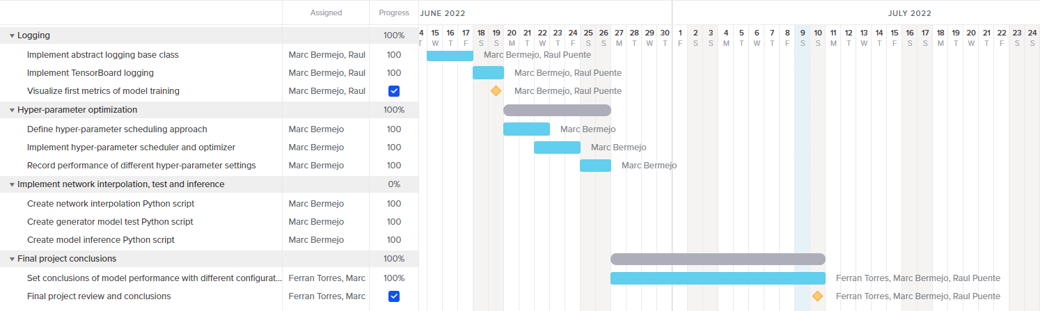
PROJECT
MILESTONES
GANTT
PROJECT ADVISOR:
DANI FOJO
GAN HYPER RESOLUTION PROJECT
MARC BERMEJO
RAUL PUENTE
FERRAN TORRES
Notes:
Milestone M1 - 11/05: Project preparation completed (100%)
Milestone M2 - 24/05: Dataset preparation and loading ready (90%)
Milestone M3 - 12/05: First model training (0%)
Milestone M4 - 19/06: Visualize first metrics of model training (0%)
Milestone M5 - 10/07: Final project review and conclusions (0%)

Slide 9


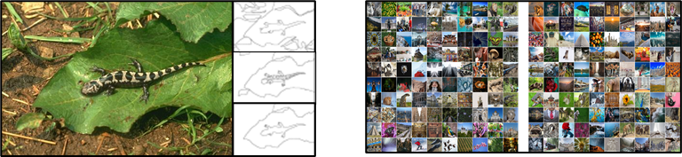
BSDS500
DIV2K
DATASETS
CONSIDERED
Standard benchmark for edge and contour detection segmentation.
Consists of 500 images, each with 5 different ground truth segmentations.
Contains:
200 images for training.
100 images for validation.
200 images for testing.
Recommended for SR given the different types of degradations contained in this dataset.
Different upscaling and downscaling steps applied to obtain those degradations..
1000 images. All with 2K resolution.
Contains:
800 images for training.
100 images for validation.
100 images for testing
PROJECT ADVISOR:
DANI FOJO
GAN HYPER RESOLUTION PROJECT
MARC BERMEJO
RAUL PUENTE
FERRAN TORRES
Notes:
Notes
2K Resolution: At least one of the axes contains 2K pixels.
DIV2K used mainly bicubic interpolation and unknown method at downscaling to obtain the degradations
DIV2K testing images not possible to download.
Links:
BSDS500: https://www2.eecs.berkeley.edu/Research/Projects/CS/vision/grouping/resources.html#bsds500
BSDS500(2): https://people.ee.ethz.ch/~timofter/publications/Agustsson-CVPRW-2017.pdf
DIV2K: https://data.vision.ee.ethz.ch/cvl/DIV2K/
DIV2K(2): https://paperswithcode.com/dataset/div2k

Slide 10



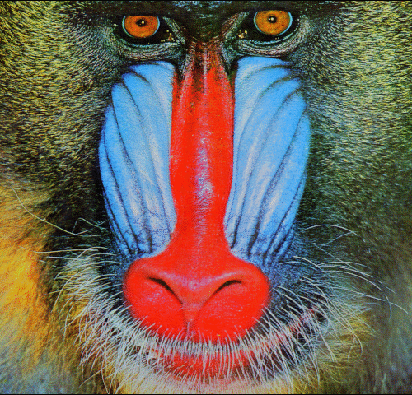
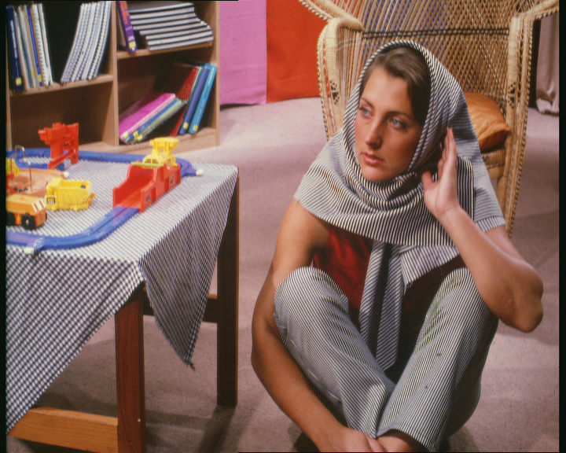
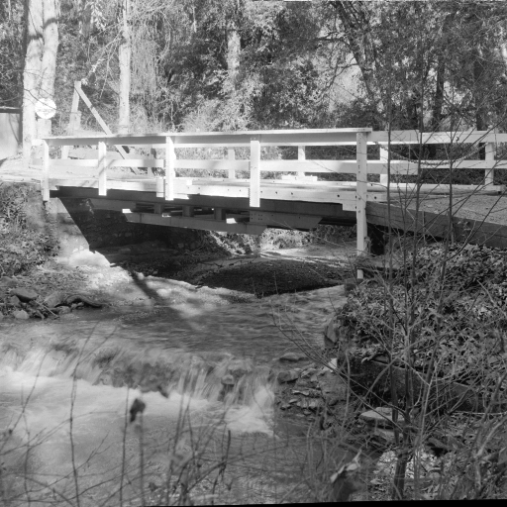
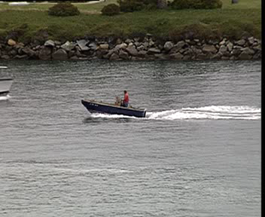

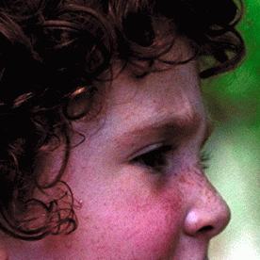




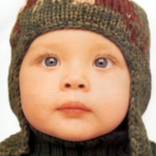

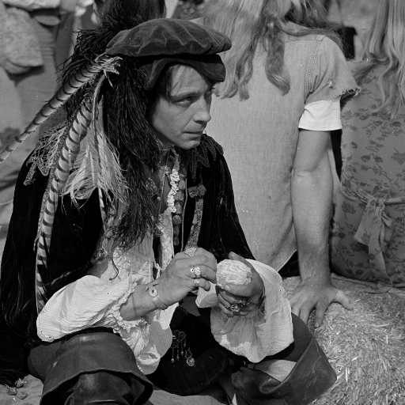
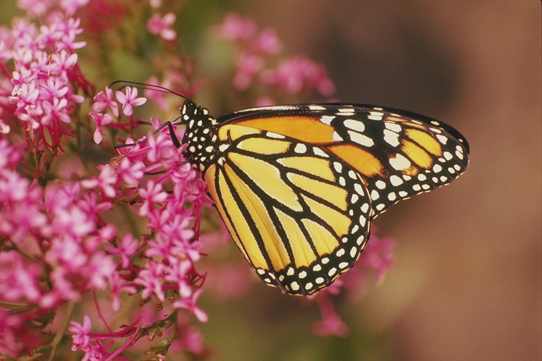
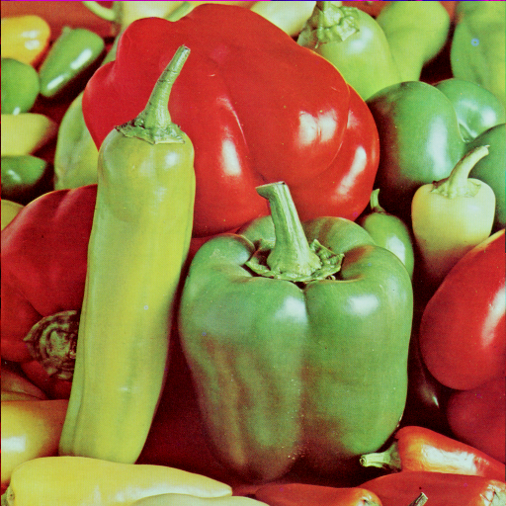
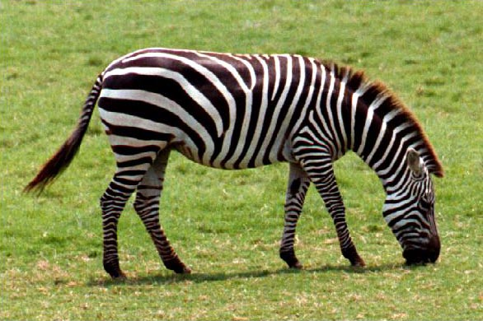
SET5
SET14
DATASETS
CONSIDERED
Dataset that consists of 5 images (“baby”, “bird”, “butterfly”, “head”, “woman”).
Commonly used for testing performance of Image Super-Resolution models.
Dataset consisting of 14 images.
Commonly used for testing performance of Image Super-Resolution models.
PROJECT ADVISOR:
DANI FOJO
GAN HYPER RESOLUTION PROJECT
MARC BERMEJO
RAUL PUENTE
FERRAN TORRES
Notes:
Notes
2K Resolution: At least one of the axes contains 2K pixels.
DIV2K used mainly bicubic interpolation and unknown method at downscaling to obtain the degradations
DIV2K testing images not possible to download.
Links:
BSDS500: https://www2.eecs.berkeley.edu/Research/Projects/CS/vision/grouping/resources.html#bsds500
BSDS500(2): https://people.ee.ethz.ch/~timofter/publications/Agustsson-CVPRW-2017.pdf
SET5: https://paperswithcode.com/dataset/set5
SET5(2): http://people.rennes.inria.fr/Aline.Roumy/results/SR_BMVC12.html.
DIV2K: https://data.vision.ee.ethz.ch/cvl/DIV2K/
DIV2K(2): https://paperswithcode.com/dataset/div2k

Slide 11

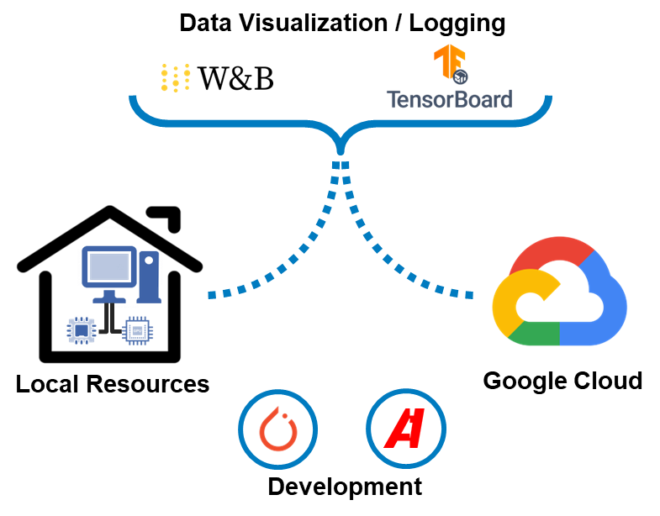

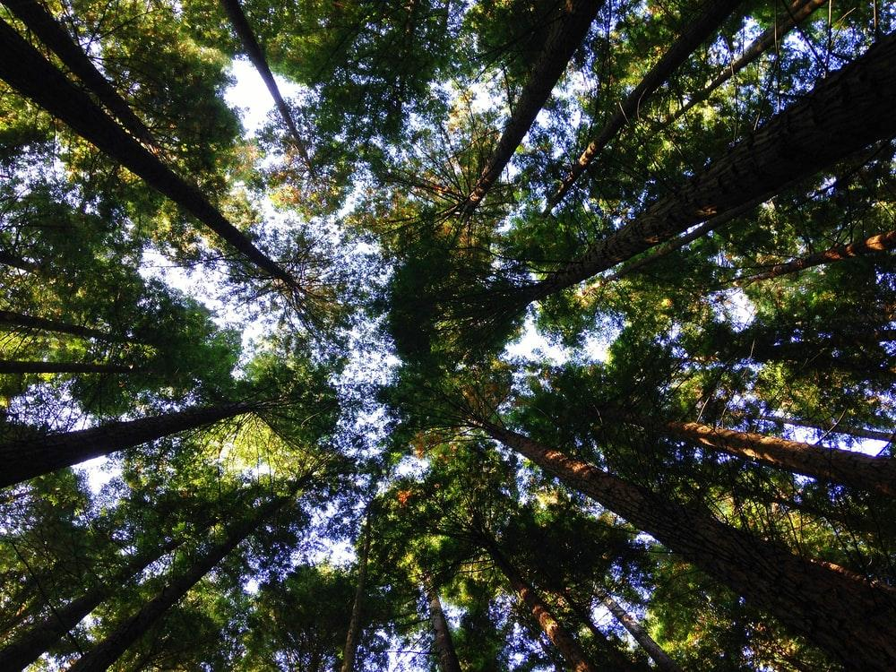
ENVIRONMENT
USED
PROJECT ADVISOR:
DANI FOJO
GAN HYPER RESOLUTION PROJECT
MARC BERMEJO
RAUL PUENTE
FERRAN TORRES
Notes:
Text
The project has been fully implemented using Pytorch Framework. Additionally, the Albumentations library has been included in order to perform the crops and different transformations to the images from the Dataset.
Most of the trials have been carried out within local environment because the availability of the equipment and the timing constraints that the project has faced.
Once the project reached an acceptable level of maturity, different trainings have been performed in a Google Cloud environment parallelizing the one running locally.
In terms of data visualization and logging, both Wandb and Tensorboard have been included into the project given that W&B can support Tensorboard and each of them provides additional features. For example: Wandb allows tracking the images created after each epoch and Tensorboard displays the Graph execution.
Icons
CPU, SERVER: https://www.iconexperience.com/o_collection/icons/?icon=cpu2&color_style=green_dark_grey
GPU: https://www.nicepng.com/ourpic/u2w7q8q8e6e6t4q8_nvidia-icon-gpu-gpu-icon/

Slide 12

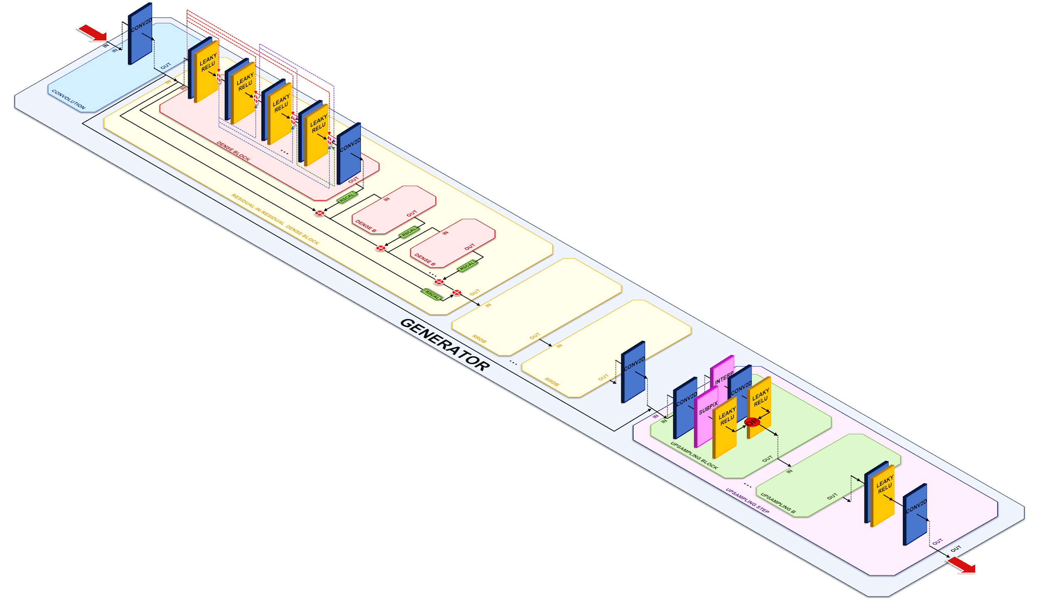
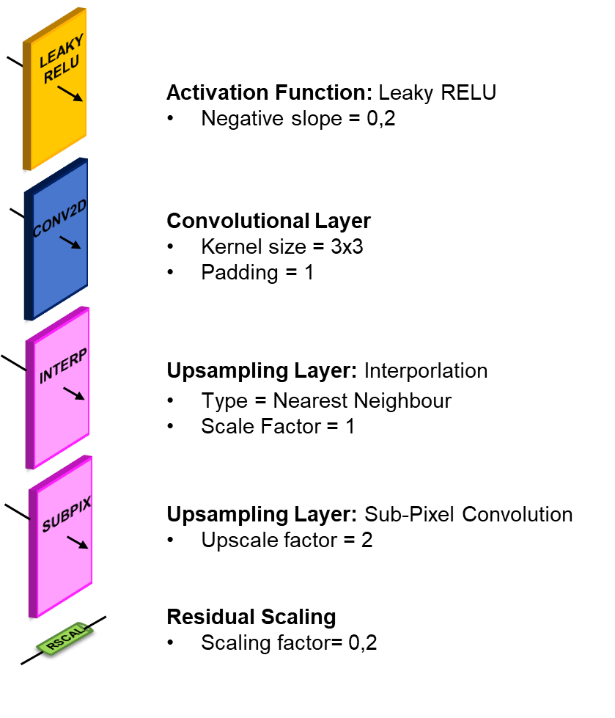
MODEL
DEFINITION
PROJECT ADVISOR:
DANI FOJO
GAN HYPER RESOLUTION PROJECT
MARC BERMEJO
RAUL PUENTE
FERRAN TORRES

Slide 13
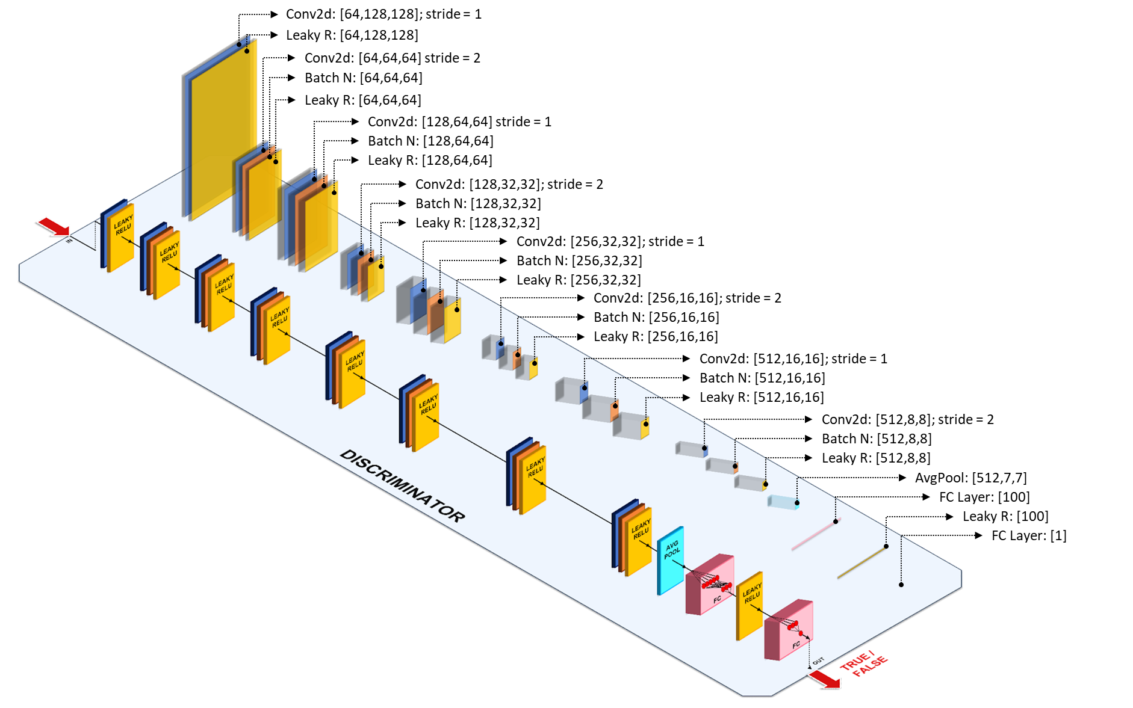

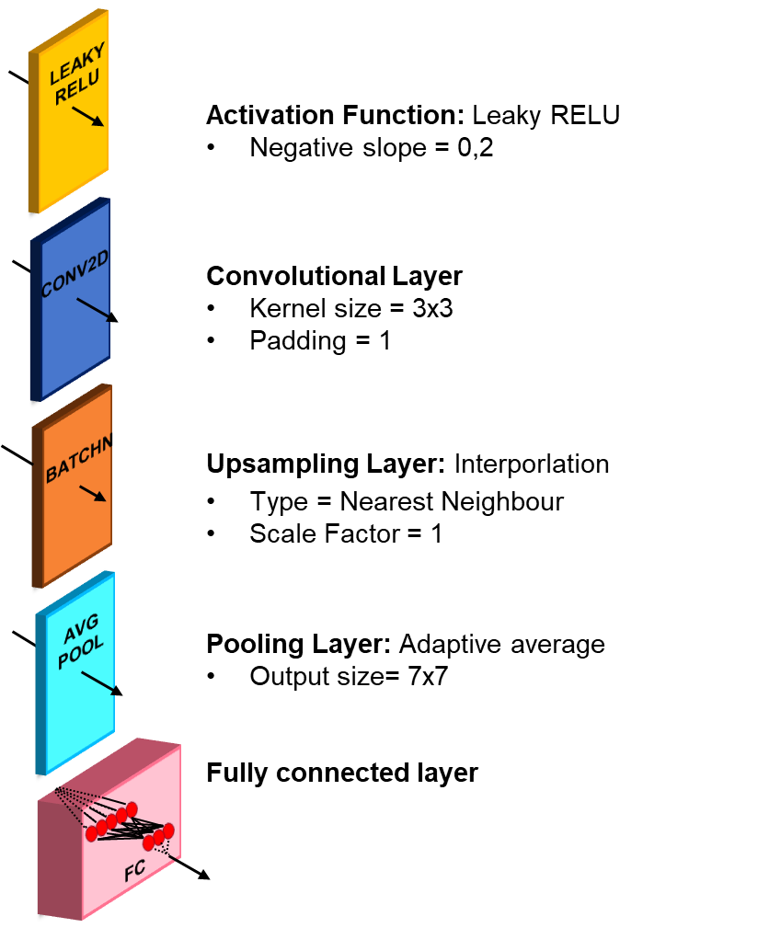
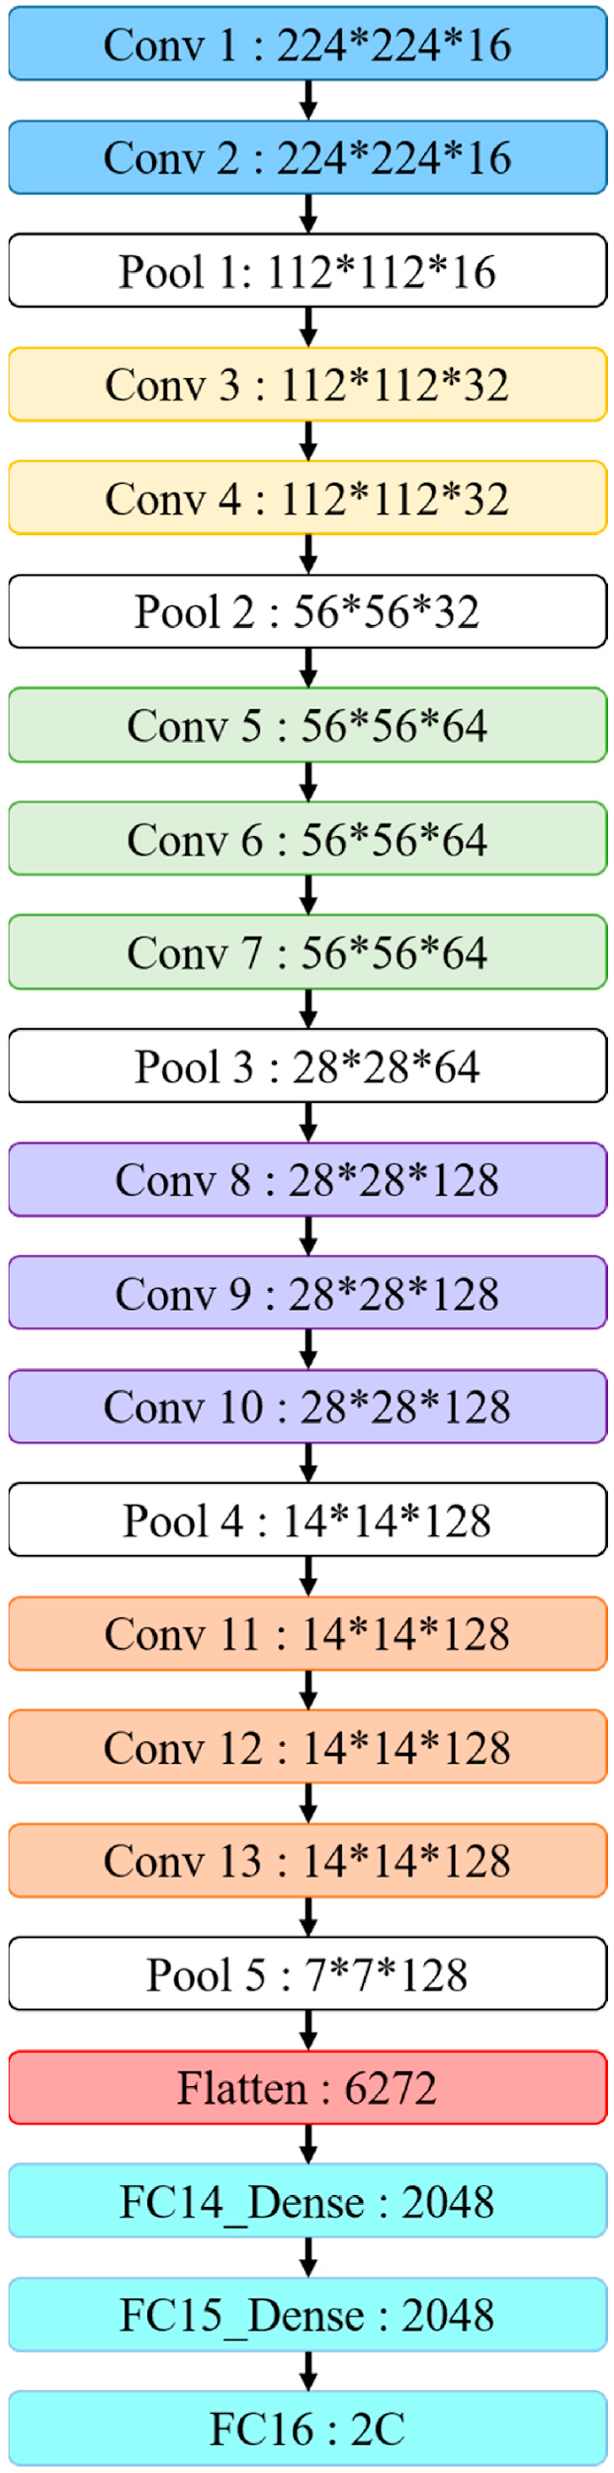
MODEL
DEFINITION
PROJECT ADVISOR:
DANI FOJO
GAN HYPER RESOLUTION PROJECT
MARC BERMEJO
RAUL PUENTE
FERRAN TORRES

Slide 14
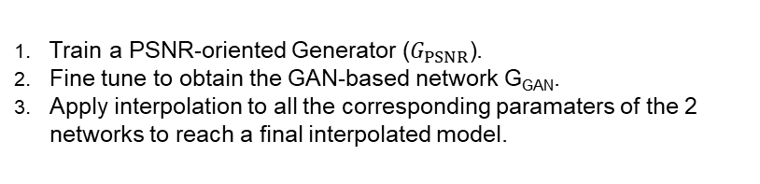
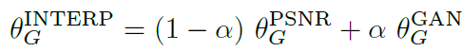
To remove unpleasant noise in GAN-based methods while maintain a good perceltual quality, we use Network Interpolation. That means that we first train a PSNR-oriented network GPSNR and then obtain a GAN-based network GGAN.
We interpolate all the corresponding parameters of these two networks to derive an interpolated model GINTERP, whose parameters are:
θGINTERP=(1−α)θGPSNR+αθGGAN
where θGINTERP, θGPSNR and θGGAN are the parameters of GINTERP, GPSNR and GGAN respectively, and α ∈ [0, 1] is the interpolation parameter.
Network Interpolation:
Used to remove unpleasant noise generated by the GAN maintaining a Good perceptual quality.
Process followed:
Formula:
MODEL
DEFINITION
α= Interpolation parameter
PROJECT ADVISOR:
DANI FOJO
GAN HYPER RESOLUTION PROJECT
MARC BERMEJO
RAUL PUENTE
FERRAN TORRES
In order to balance the visual quality and RMSE/PSNR, we further propose
the network interpolation strategy, which could continuously adjust the recon-
struction style and smoothness. Another alternative is image interpolation, which
directly interpolates images pixel by pixel. We employ this strategy to partici-
pate in region 1 and region 2. The network interpolation and image interpolation
strategies and their dierences are discussed in Sec. 3.4.

Slide 15
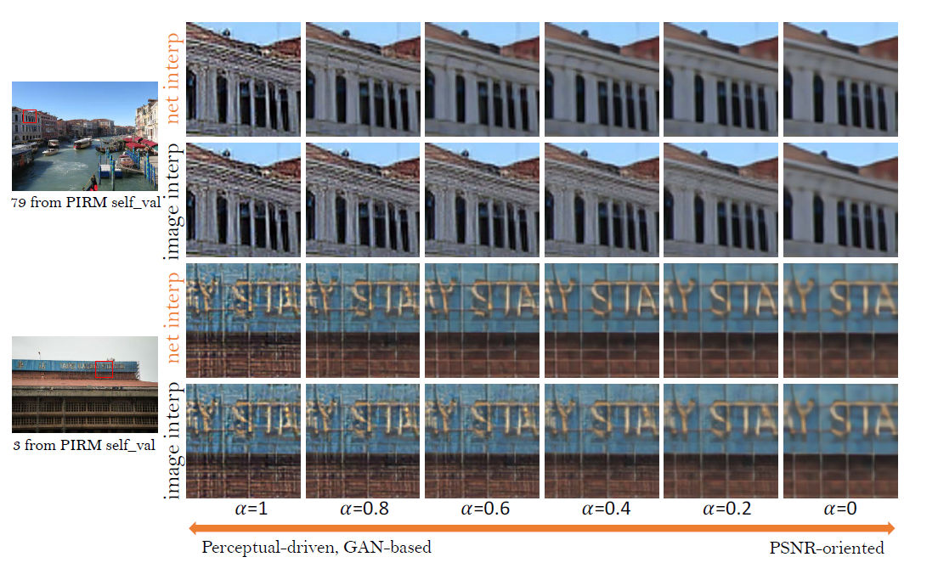
Network Interpolation:
MODEL
DEFINITION
PROJECT ADVISOR:
DANI FOJO
GAN HYPER RESOLUTION PROJECT
MARC BERMEJO
RAUL PUENTE
FERRAN TORRES
In order to balance the visual quality and RMSE/PSNR, we further propose
the network interpolation strategy, which could continuously adjust the recon-
struction style and smoothness. Another alternative is image interpolation, which
directly interpolates images pixel by pixel. We employ this strategy to partici-
pate in region 1 and region 2. The network interpolation and image interpolation
strategies and their dierences are discussed in Sec. 3.4.

Slide 16


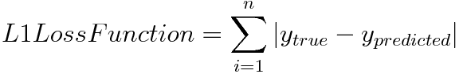
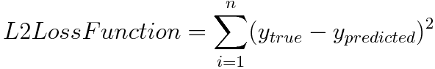
Content Loss (L_{content}):
Mean error calculated between each pixel from the real image from the generated one.
Ensures that the activations of higher layers are similar between the Ground Truth and the generated images.
The project is prepared to work either with L1 (Mean Absolute Error) or L2 (Mean Squared Error) functions. Set to L1 by default.
Formula:
LOSS
FUNCTION
PROJECT ADVISOR:
DANI FOJO
GAN HYPER RESOLUTION PROJECT
MARC BERMEJO
RAUL PUENTE
FERRAN TORRES
Notes:
Links:
Content Loss: https://pytorch.org/tutorials/advanced/neural_style_tutorial.html
Content Loss: https://jonathan-hui.medium.com/gan-super-resolution-gan-srgan-b471da7270ec
Content Loss: https://towardsdatascience.com/light-on-math-machine-learning-intuitive-guide-to-neural-style-transfer-ef88e46697ee
https://keras.io/examples/generative/neural_style_transfer/

Slide 17
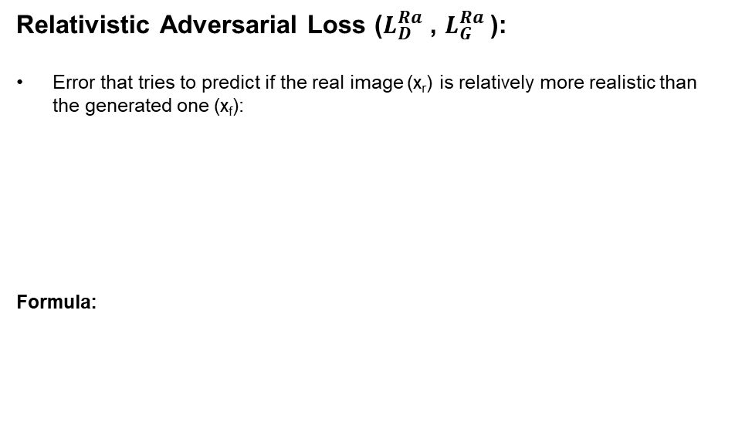
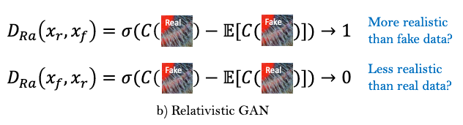
When a ground truth image G with N pixels is available the quality of a corresponding (degraded or restored) image I can be defined as the pixel-level fidelity to the ground truth. Representatives are Mean Square Error (MSE) defined by MSE = 1 N PN i=1 (Gi − Ii) 2 where Gi (or Ii) is the i-th pixels of G (or I), and Peak Signal-to-Noise Ratio (PSNR), P SNR = 10 log10 MAX2 G MSE where MAXG is the maximum possible pixel value of the image, here 255. However, small shifts in the content of I leads to (very) poor MSE and PSNR scores even when the contents are identical. Therefore, another group of measures amounts for such structural similarity. If MSE and PSNR measure absolute errors the Structural Similarity index (SSIM) [50] 4 is a perception-based model that considers image degradation as perceived change in structural information and Information Fidelity Criterion (IFC) [40] 5 assesses the image quality based on natural scene statistics.
LOSS
FUNCTION
σ = Sigmoid
C(x) = Non-Transformed discriminator output
E_{xf}[·] = Average for all fake data in a minibatch
x_{f}=G(x_{i})
x_{f}=LR image
PROJECT ADVISOR:
DANI FOJO
GAN HYPER RESOLUTION PROJECT
MARC BERMEJO
RAUL PUENTE
FERRAN TORRES
Notes:
Link
https://keras.io/examples/generative/neural_style_transfer/

Slide 18
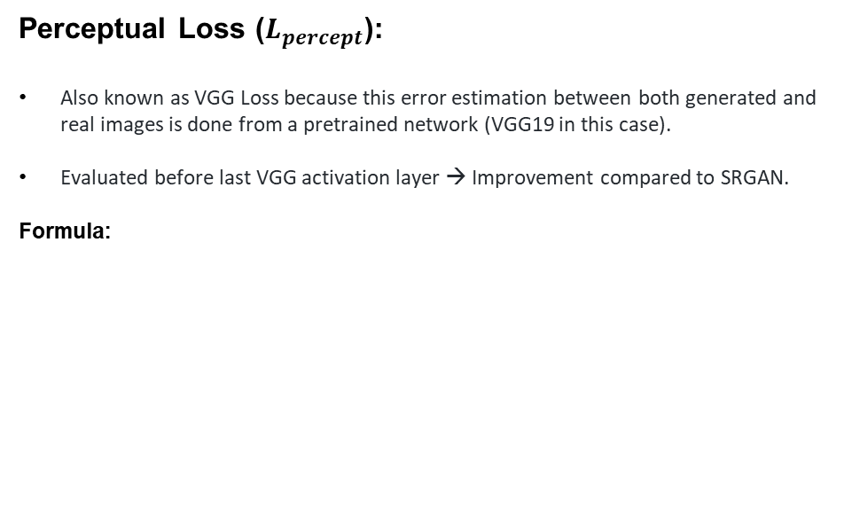
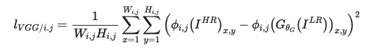
LOSS
FUNCTION
PROJECT ADVISOR:
DANI FOJO
GAN HYPER RESOLUTION PROJECT
MARC BERMEJO
RAUL PUENTE
FERRAN TORRES
Notes:
Link
Perceptual Loss: https://arxiv.org/pdf/1809.00219.pdf

Slide 19
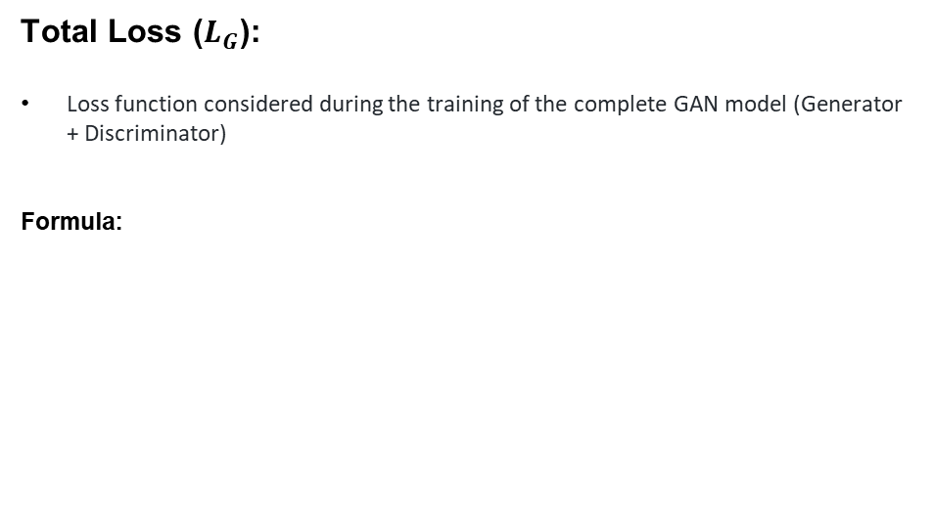
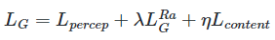
LOSS
FUNCTION
λ, η= weights assigned to each Loss function to balance terms
PROJECT ADVISOR:
DANI FOJO
GAN HYPER RESOLUTION PROJECT
MARC BERMEJO
RAUL PUENTE
FERRAN TORRES

Slide 20

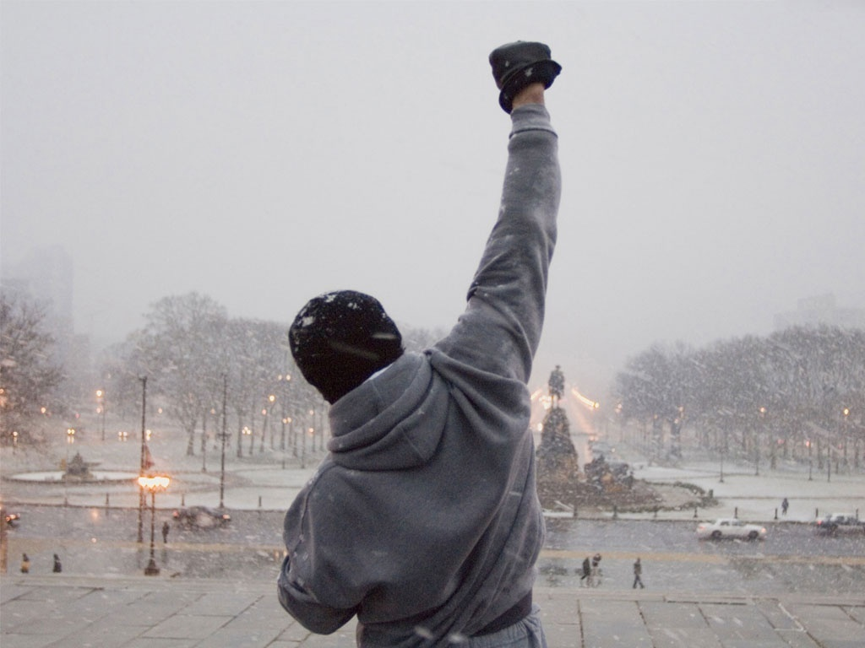


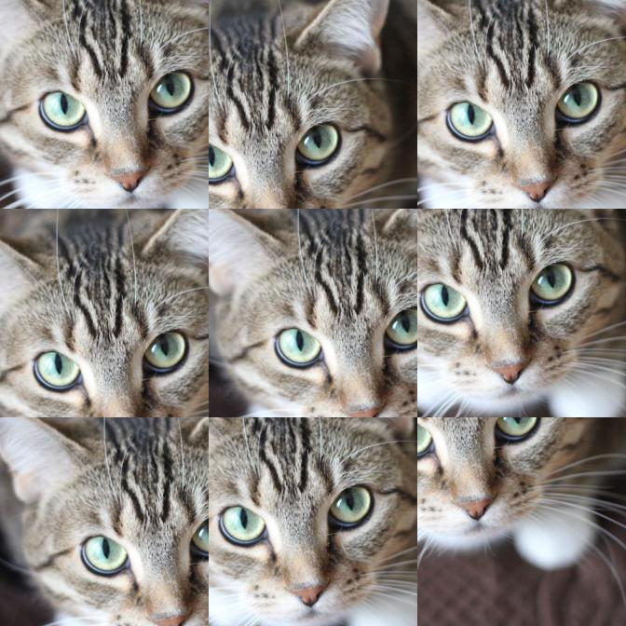
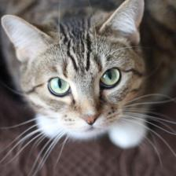
1
Image retrieval
TRAINING
1
A
HR & LR
B
HR
PROCESS
HR & LR Load
Center Crop
(
Scale Factor)
2
LR image generation
“Nearest” Interpolation
A
Train
B
Validate
DATASET PRE-PROCESSING
Random Crop
Center Crop
3
User-defined transforms
PROJECT ADVISOR:
DANI FOJO
GAN HYPER RESOLUTION PROJECT
MARC BERMEJO
RAUL PUENTE
FERRAN TORRES

Slide 21
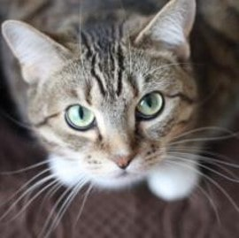
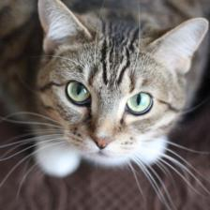

3
User-defined transforms
TRAINING
1
PROCESS
4
Warm-Up (Pre-training)
5
Training (Complete GAN)
Hard
Spatial
Spatial
Compression
Coarse Dropout
Transpose
Transpose
Flip
OR
Flip
OR
P=0,25
P=0,25
P=0,25
P=0,75
P=0,25
P=0,75
DATA AUGMENTATION
Albumentations
PROJECT ADVISOR:
DANI FOJO
GAN HYPER RESOLUTION PROJECT
MARC BERMEJO
RAUL PUENTE
FERRAN TORRES

Slide 22





Image data Augmentation
TRAINING
TRAINING
Training: Paired Random Crop
Validation: Paired Center Crop
2
Loss Function
PROCESS
STEPS
Content Loss
Training process
Generator
Optimization
Adam Optimizer with Learning rate = 2e-4
Scheduler
Steps applied = 175000 & γ=0,5
WARM-UP
Metrics Logging
Pre-training: Content Loss
Validation: Content Loss / Perceptual Loss / SSIM / PSNR
PROJECT ADVISOR:
DANI FOJO
GAN HYPER RESOLUTION PROJECT
MARC BERMEJO
RAUL PUENTE
FERRAN TORRES

Slide 23
Image data Augmentation
TRAINING
TRAINING
Random Crop for Training / Random Center Crop for Validation
Spatial Transformation
3
Loss Function
PROCESS
STEPS
Content Loss, Perceptual Loss / Generator Adversarial Loss
Training process
1- Generator training for every mini-batch freezing the Discriminator.
2- Discriminator training for same mini-batch freezing the Generator.
Optimization
Adam Optimizer with Learning rate = 1e-4
Scheduler
Steps applied = [50000, 100000, 200000, 300000] & γ=0,5
TRAINING
Metrics Logging
Content Loss, Perceptual Loss / Generator Adversarial Loss / Total Loss/ Discriminator Adversarial Lossss / Perceptual Loss/ PSNR / SSIM
PROJECT ADVISOR:
DANI FOJO
GAN HYPER RESOLUTION PROJECT
MARC BERMEJO
RAUL PUENTE
FERRAN TORRES

Slide 24


Hyperparameters | Description
scale_factor | Scale factor relation between the low resolution and the high resolution images.
batch_size | Data loader configured mini-batch size.
pretraining/num_epoch | Number of epoch needed to complete the pre-training (PSNR-driven) step.
pretraining/cr_patch_size | High-resolution image crop size. Needs to be a tuple of (H, W). If set to None, any crop transform will be applied.
pretraining/lr | Configured learning rate for the pre-training step optimizer. Adam optimizer will be used for this step.
pretraining/sched_step | Learning rate scheduler decay rate for the pre-training step.
pretraining/sched_gamma | Multiplicative factor of the learning rate scheduler decay for the pre-training step.
pretraining/train_datasets | Dataset(s) used during training of the pre-training step. Must be one of 'div2k', 'bsds500'.
pretraining/val_datasets | Dataset(s) used during validation of the pre-training step. Must be one of 'div2k', 'bsds500'.
training/num_epoch | Number of epoch needed to complete the training step.
training/cr_patch_size | Number of epoch needed to complete the pre-training (GAN-driven) step.
training/g_lr | Configured generator's learning rate for the training step optimizer. Adam optimizer will be used for this step.
training/d_lr | Configured discriminator's learning rate for the training step optimizer. Adam optimizer will be used for this step.
training/g_sched_steps | List of mini-batch indices learning rate decay of the generator's training scheduler.
training/g_sched_gamma | Multiplicative factor of the generator's learning rate scheduler decay for the training step.
training/d_sched_steps | List of mini-batch indices learning rate decay of the discriminator's training scheduler.
training/train_datasets | Dataset(s) used during training of the training step. Must be one of 'div2k', 'bsds500'.
training/val_datasets | Dataset(s) used during validation of the training step. Must be one of 'div2k', 'bsds500'.
generator/num_basic_blocks | Number of basic (a.k.a residual-on-residual dense blocks) of the generator network.
training/d_sched_gamma | Multiplicative factor of the discriminator's learning rate scheduler decay for the training step.
HYPER-
PARAMETERS
PROJECT ADVISOR:
DANI FOJO
GAN HYPER RESOLUTION PROJECT
MARC BERMEJO
RAUL PUENTE
FERRAN TORRES
Notes:
BSDS500: https://www2.eecs.berkeley.edu/Research/Projects/CS/vision/grouping/resources.html#bsds500
DIV2K: https://data.vision.ee.ethz.ch/cvl/DIV2K/

Slide 25
Model | Training Data | SET5 |  | SET14
 |  | PSNR | SSIM | PSNR | SSIM
Pre-CR: 128 / CR: 128 / 23 RRDBs: | DIV2K | 32,47dB | 0,9335 | 31,01dB | 0,9749
Pre-CR: 192 / CR: 192 / 23 RRDBs: | DIV2K | 32,30dB | 0,9329 | 31,20dB | 0,9746
Pre-CR: 192 / CR: 128 / 23 RRDBs: | DIV2K+BSDS500 | 31,93dB | 0,9266 | 30,57dB | 0,9717
Pre-CR: 192 / CR: 128 / 16 RRDBs: | DIV2K+BSDS500 | 32,01dB | 0,9274 | 30,75dB | 0,9730
Leverxgroup ESRG | DIVX | 32,73dB | 0,9011 | 28,99dB | 0,7917
Hyperparameters
scale_factor | 4 | 4 | 4 | 4
batch_size | 16 | 16 | 16 | 16
pretraining/num_epoch | 8000 | 8000 | 8000 | 8000
pretraining/cr_patch_size | [192,192] | [128, 128] | [192,192] | [192,192]
pretraining/lr | 0,0002 | 0,0002 | 0,0002 | 0,0002
pretraining/sched_step | 175000 | 175000 | 175000 | 175000
pretraining/sched_gamma | 0.5 | 0.5 | 0.5 | 0.5
pretraining/train_datasets | ["div2k"] | ["div2k"] | ["bsds500", "div2k"] | ["bsds500", "div2k"]
pretraining/val_datasets | ["div2k"] | ["div2k"] | ["div2k"] | ["div2k"]
training/num_epoch | 6000 | 6000 | 6000 | 6000
training/cr_patch_size | [192,192] | [128, 128] | [128, 128] | [128, 128]
training/g_lr | 0,0001 | 0,0001 | 0,0001 | 0,0001
training/d_lr | 0,0001 | 0,0001 | 0,0001 | 0,0001
training/g_sched_steps | [50000, 100000, 175000, 250000] | [50000, 100000, 175000, 250000] | [50000, 100000, 175000, 250000] | [50000, 100000, 175000, 250000]
training/g_sched_gamma | 0.5 | 0.5 | 0.5 | 0.5
training/d_sched_steps | [50000, 100000, 175000, 250000] | [50000, 100000, 175000, 250000] | [50000, 100000, 175000, 250000] | [50000, 100000, 175000, 250000]
training/train_datasets | ["div2k"] | ["div2k"] | ["bsds500", "div2k"] | ["bsds500", "div2k"]
training/val_datasets | ["div2k"] | ["div2k"] | ["div2k"] | ["div2k"]
generator/num_basic_blocks | 23 | 23 | 16 | 23
training/d_sched_gamma | 0.5 | 0.5 | 0.5 | 0.5
HYPER-
PARAMETERS
scale_factor
batch_size
pretraining/num_epoch
pretraining/cr_patch_size
pretraining/lr
pretraining/sched_step
pretraining/sched_gamma
pretraining/train_datasets
pretraining/val_datasets
training/num_epoch
training/cr_patch_size
training/g_lr
training/d_lr
training/g_sched_steps
training/g_sched_gamma
training/d_sched_steps
training/d_sched_gamma
training/train_datasets
W* / Train
Patch size: 128 / 128 RRDB: 23 Dataset: DIV2K
Patch size: 192 / 128 RRDB: 23 Dataset: DIV2K + BSDS500
Patch size: 192 / 192 RRDB: 23 Dataset: DIV2K
Patch size: 192 / 128 RRDB: 16 Dataset: DIV2K + BSDS500
W* → Warm Up / Pre-Training
PROJECT ADVISOR:
DANI FOJO
GAN HYPER RESOLUTION PROJECT
MARC BERMEJO
RAUL PUENTE
FERRAN TORRES
training/val_datasets
generator/num_basic_blocks
pretraining/train_datasets
training/train_datasets
Notes:
BSDS500: https://www2.eecs.berkeley.edu/Research/Projects/CS/vision/grouping/resources.html#bsds500
DIV2K: https://data.vision.ee.ethz.ch/cvl/DIV2K/

Slide 26


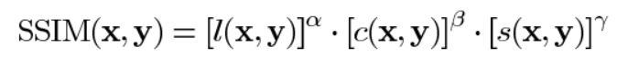
Structural Similarity Index(SSIM):
Given 2 images, SSIM is an index with values in the range (-1,1), which estimates the level of similarity between those two images.
It combines different comparison functions:
Formula:
QUALITY
METRICS
+1 = very similar or the same.
-1 = very different
Luminance l(x,y).
Contrast c(x,y)
Structure s(x,y)
α,β,γ= weights assigned to each feature
PROJECT ADVISOR:
DANI FOJO
GAN HYPER RESOLUTION PROJECT
MARC BERMEJO
RAUL PUENTE
FERRAN TORRES
Notes:
Links
SSIM: https://medium.com/srm-mic/all-about-structural-similarity-index-ssim-theory-code-in-pytorch-6551b455541e

Slide 27
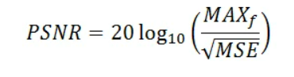
Peak Signal-to-Noise (PSNR):
Ratio between maximum possible value (power) of a signal and power of distorting noise that affects the quality of its representation.
Metric used to compare different image enhancement algorithms systematically to evaluate which produces better results using the same dataset.
Formula:
QUALITY
METRICS
MSE = L2 loss
MAX_{f} = Maximum existing signal value in our original “known to be good” image.
PROJECT ADVISOR:
DANI FOJO
GAN HYPER RESOLUTION PROJECT
MARC BERMEJO
RAUL PUENTE
FERRAN TORRES
Notes:
Links
PSNR: https://www.ni.com/es-es/innovations/white-papers/11/peak-signal-to-noise-ratio-as-an-image-quality-metric.html

Slide 28


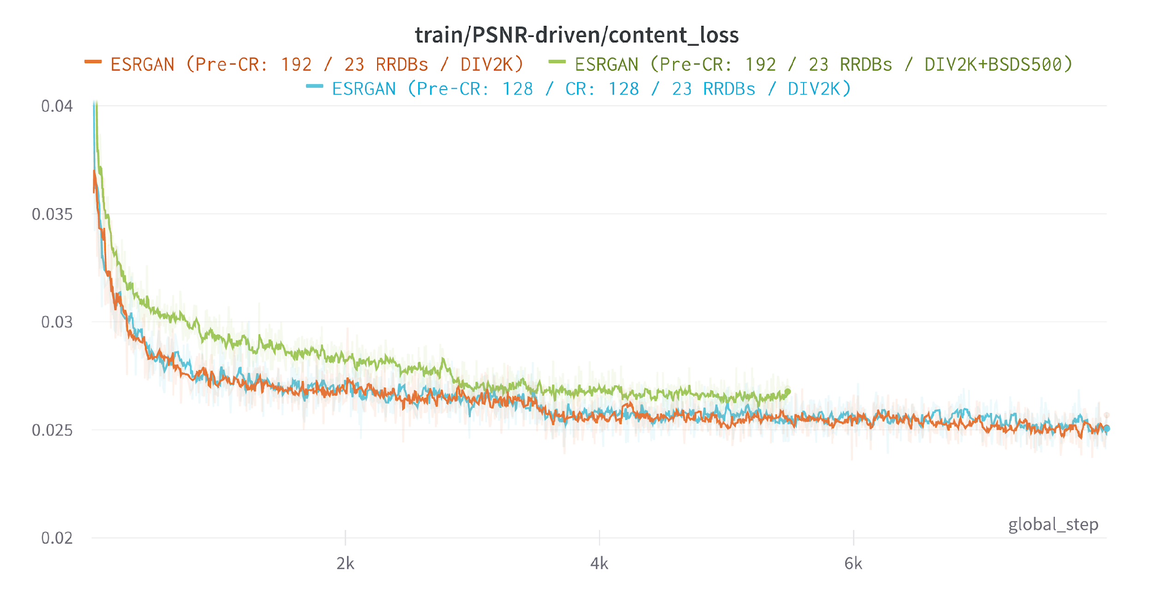
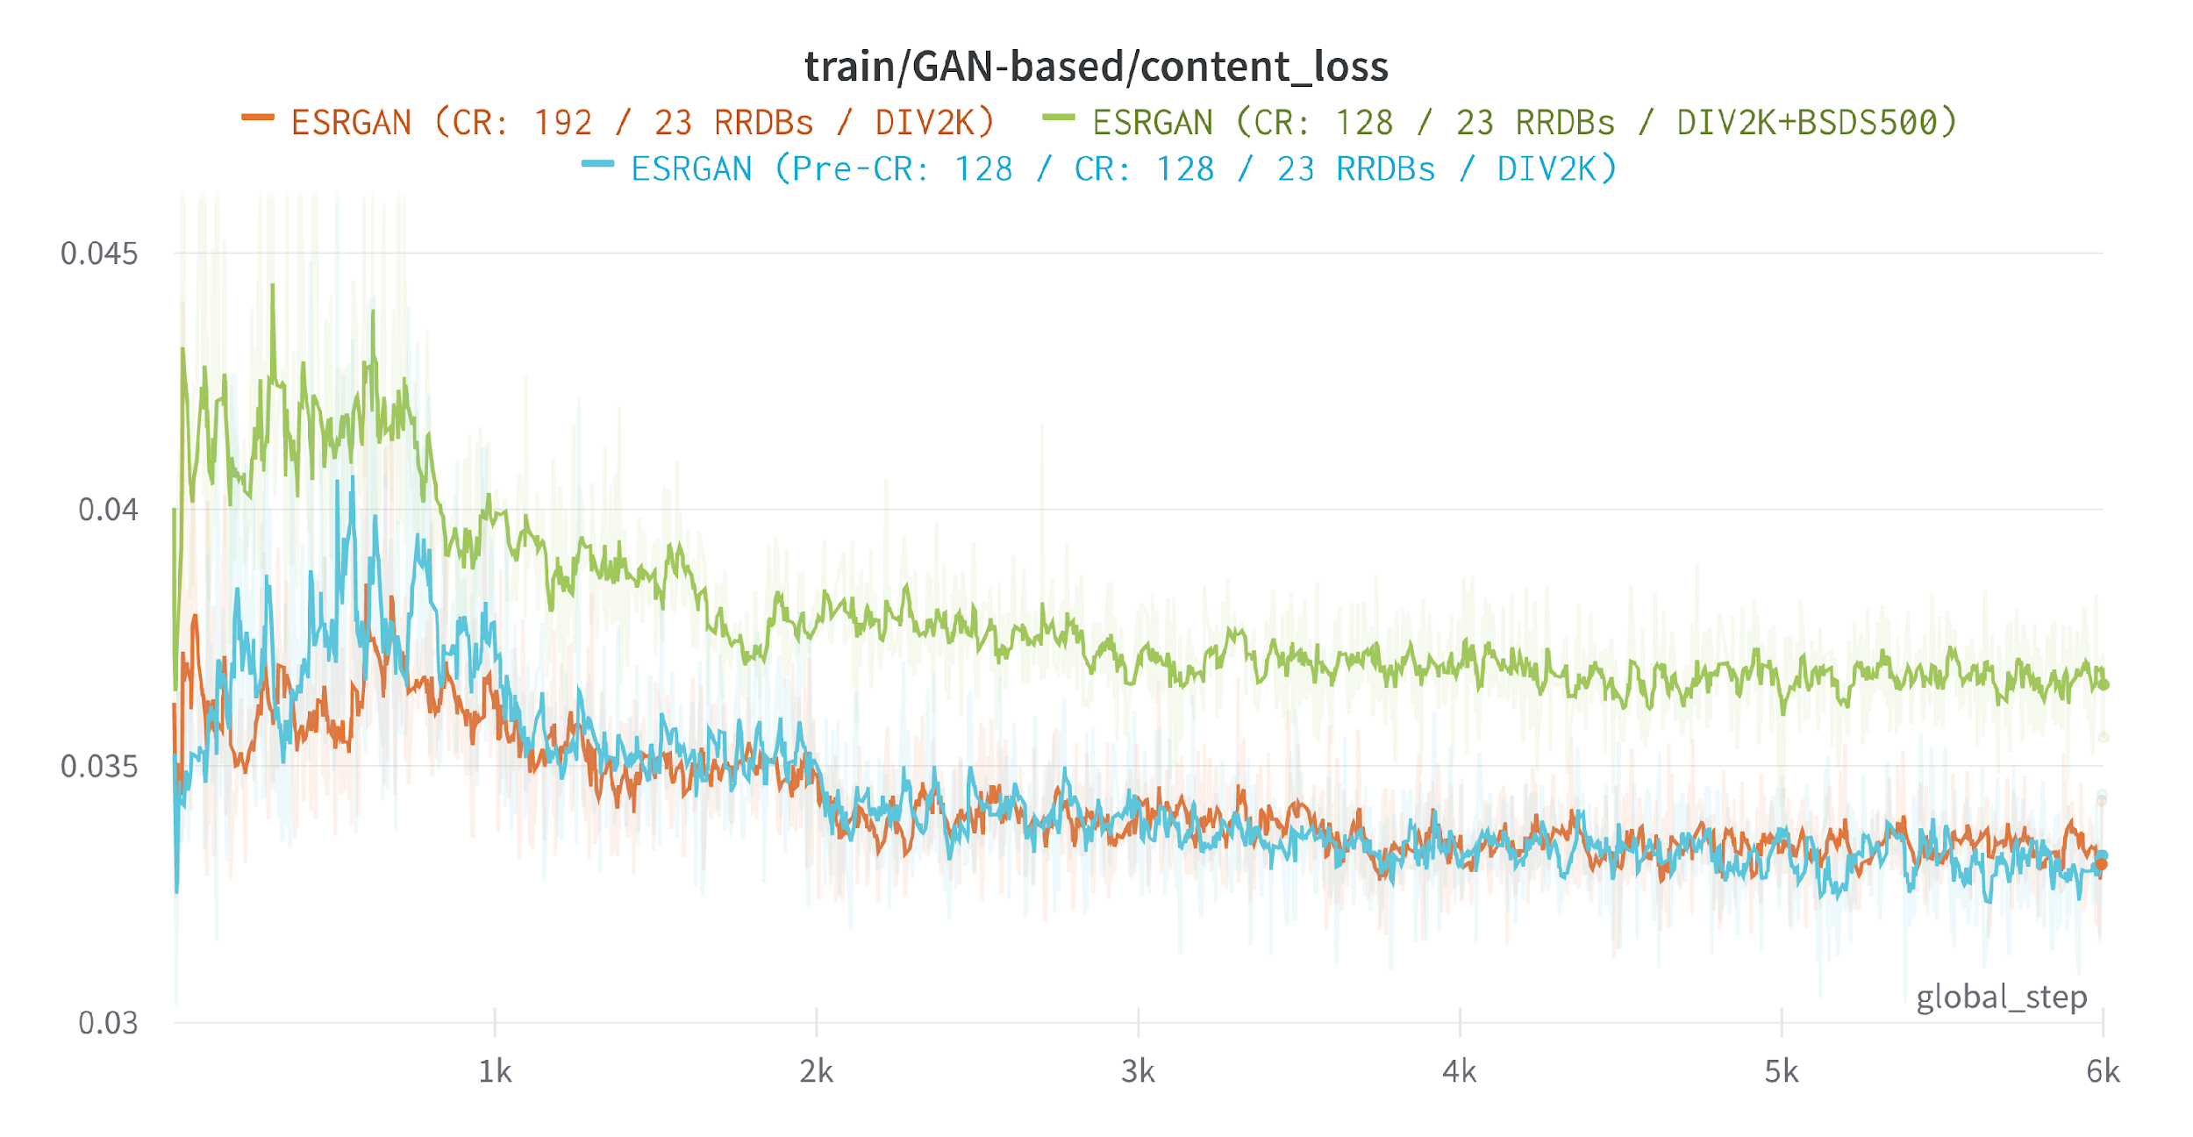
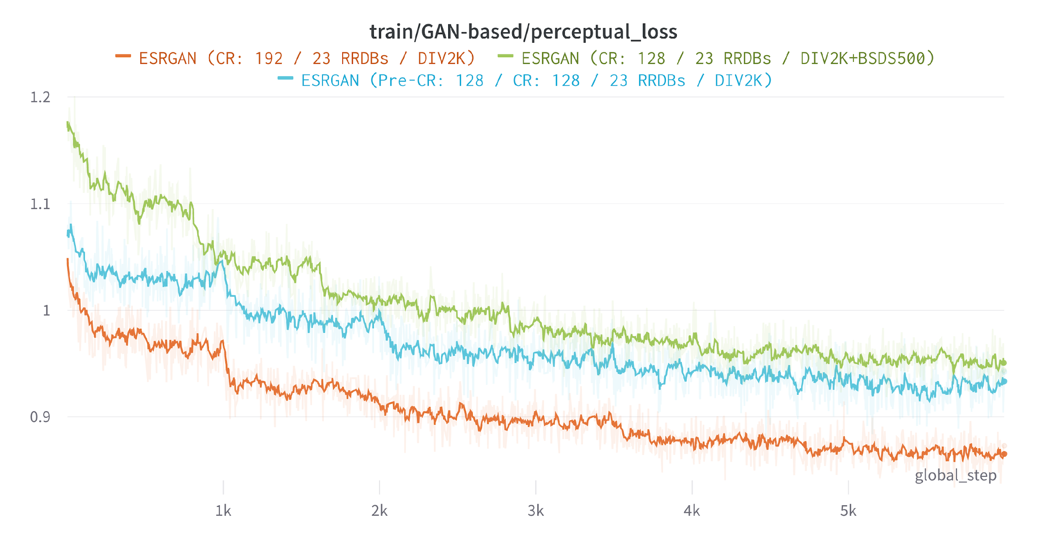
CONTENT LOSS WARM-UP
RESULTS FOR
DISCUSSION
CONTENT LOSS TRAINING
PERCEPTUAL LOSS TRAINING
PROJECT ADVISOR:
DANI FOJO
GAN HYPER RESOLUTION PROJECT
MARC BERMEJO
RAUL PUENTE
FERRAN TORRES

Slide 29
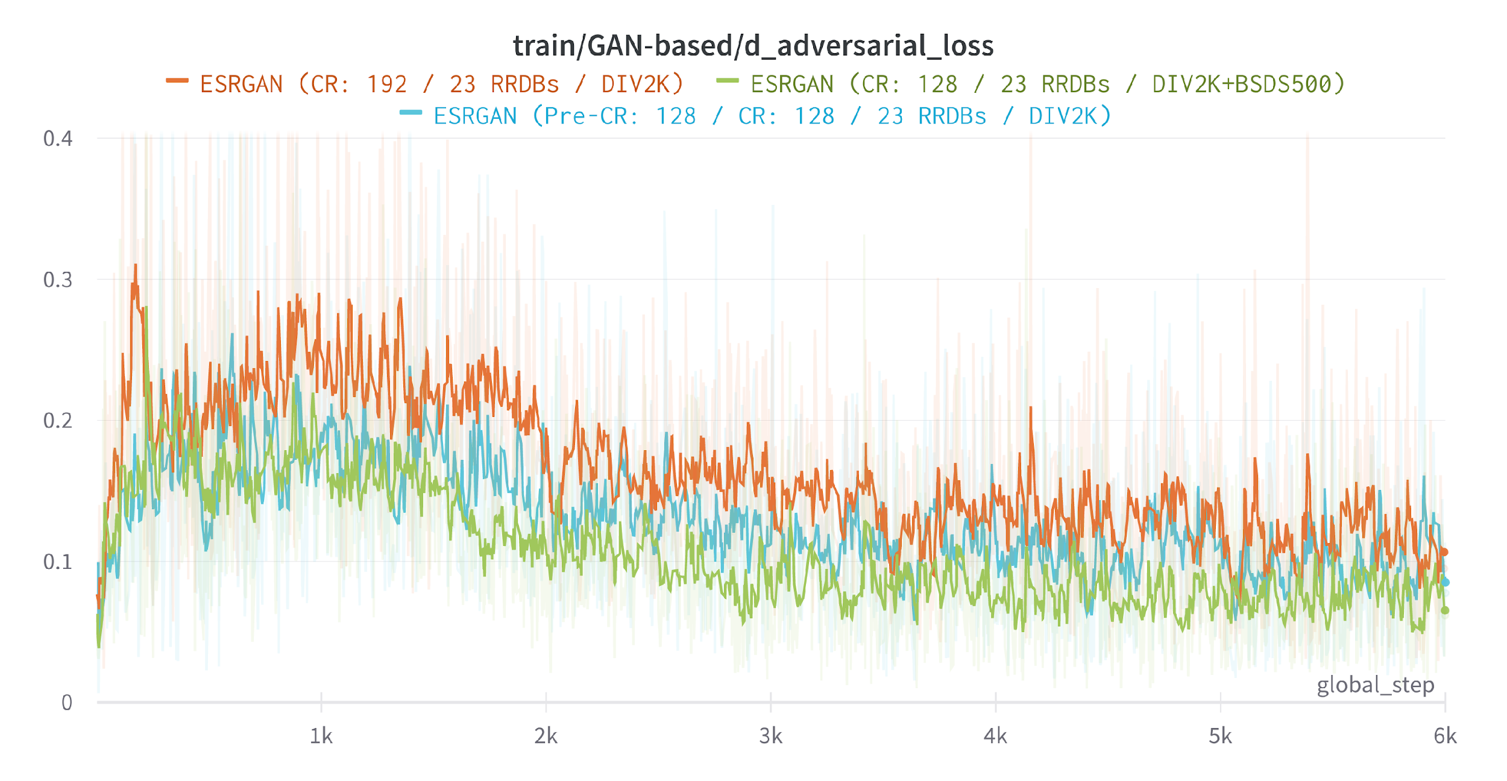
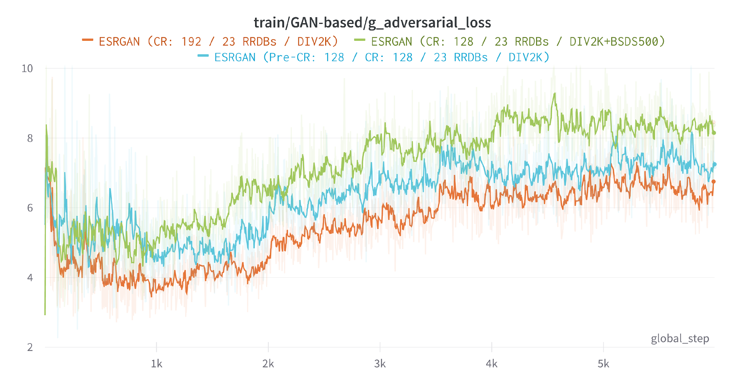
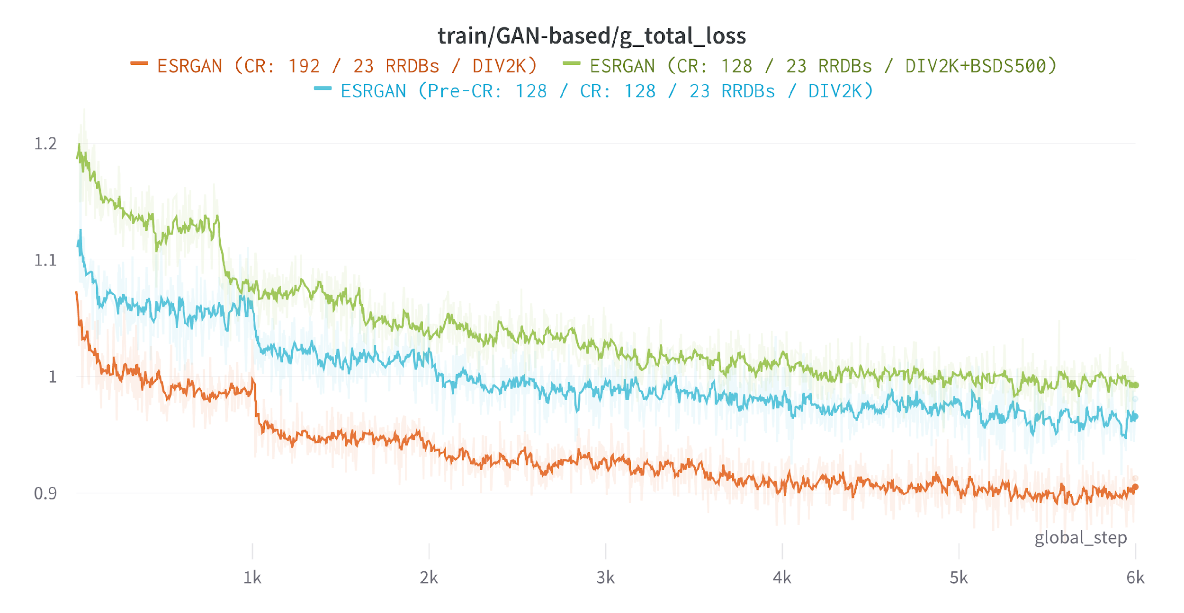
DISCRIMINATOR ADVERSARIAL LOSS TRAINING
GENERATOR ADVERSARIAL LOSS TRAINING
RESULTS FOR
DISCUSSION
TOTAL LOSS GAN TRAINING
PROJECT ADVISOR:
DANI FOJO
GAN HYPER RESOLUTION PROJECT
MARC BERMEJO
RAUL PUENTE
FERRAN TORRES

Slide 30
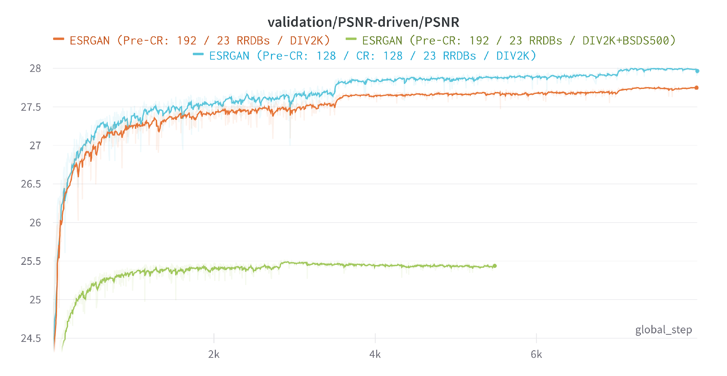



PSNR WARM-UP VALIDATION
SSIM WARM-UP VALIDATION
RESULTS FOR
DISCUSSION
CONTENT LOSS WARM-UP VALIDATION
PERCEPTUAL LOSS WARM-UP VALIDATION
PROJECT ADVISOR:
DANI FOJO
GAN HYPER RESOLUTION PROJECT
MARC BERMEJO
RAUL PUENTE
FERRAN TORRES

Slide 31




PERCEPTUAL LOSS GAN VALIDATION
CONTENT LOSS GAN VALIDATION
RESULTS FOR
DISCUSSION
PSNR GAN VALIDATION
SSIM GAN VALIDATION
PROJECT ADVISOR:
DANI FOJO
GAN HYPER RESOLUTION PROJECT
MARC BERMEJO
RAUL PUENTE
FERRAN TORRES

Slide 32




RESULTS FOR
DISCUSSION
W* / Train
Patch size: 128 / 128 RRDB: 23 Dataset: DIV2K
Patch size: 192 / 128 RRDB: 23 Dataset: DIV2K + BSDS500
Patch size: 192 / 192 RRDB: 23 Dataset: DIV2K
Patch size: 192 / 128 RRDB: 16 Dataset: DIV2K + BSDS500
W* → Warm Up / Pre-Training
PROJECT ADVISOR:
DANI FOJO
GAN HYPER RESOLUTION PROJECT
MARC BERMEJO
RAUL PUENTE
FERRAN TORRES

Slide 33




RESULTS FOR
DISCUSSION
W* / Train
Patch size: 128 / 128 RRDB: 23 Dataset: DIV2K
Patch size: 192 / 128 RRDB: 23 Dataset: DIV2K + BSDS500
Patch size: 192 / 192 RRDB: 23 Dataset: DIV2K
Patch size: 192 / 128 RRDB: 16 Dataset: DIV2K + BSDS500
W* → Warm Up / Pre-Training
PROJECT ADVISOR:
DANI FOJO
GAN HYPER RESOLUTION PROJECT
MARC BERMEJO
RAUL PUENTE
FERRAN TORRES

Slide 34




RESULTS FOR
DISCUSSION
W* / Train
Patch size: 128 / 128 RRDB: 23 Dataset: DIV2K
Patch size: 192 / 128 RRDB: 23 Dataset: DIV2K + BSDS500
Patch size: 192 / 192 RRDB: 23 Dataset: DIV2K
Patch size: 192 / 128 RRDB: 16 Dataset: DIV2K + BSDS500
W* → Warm Up / Pre-Training
PROJECT ADVISOR:
DANI FOJO
GAN HYPER RESOLUTION PROJECT
MARC BERMEJO
RAUL PUENTE
FERRAN TORRES

Slide 35
[Pre-CR: 128 / CR: 128 / 23 RRDBs / DIV2K]:
Set5:
PSNR: 32.47db
SSIM: 0.9335
Set14:
PSNR: 31.01dB
SSIM: 0.9749
[Pre-CR: 192 / CR: 192 / 23 RRDBs / DIV2K]:
Set5:
PSNR: 32.30dB
SSIM: 0.9329
Set14:
PSNR: 31.20dB
SSIM: 0.9746
[Pre-CR: 192 / CR: 128 / 23 RRDBs / DIV2K+BSDS500]:
Set5:
PSNR: 31.93dB
SSIM: 0.9266
Set14:
PSNR: 30.57dB
SSIM: 0.9717
[Pre-CR: 192 / CR: 128 / 16 RRDBs / DIV2K+BSDS500]:
Set5:
PSNR: 32.01dB
SSIM: 0.9274
Set14:
PSNR: 30.75dB
SSIM: 0.9730
Original:
Set5:
PSNR: 32.73dB
SSIM: 0.9011
Set14:
PSNR: 28.99dB
SSIM: 0.7917
RESULTS FOR
 | Model | Datasets | SET5 |  | SET14
 |  |  | PSNR | SSIM | PSNR | SSIM
 | Pre-CR: 128 / CR: 128 / 23 RRDBs | DIV2K | 32,47dB | 0,9335 | 31,01dB | 0,9749
 | Pre-CR: 192 / CR: 192 / 23 RRDBs | DIV2K | 32,30dB | 0,9329 | 31,20dB | 0,9746
 | Pre-CR: 192 / CR: 128 / 23 RRDBs | DIV2K+BSDS500 | 31,93dB | 0,9266 | 30,57dB | 0,9717
 | Pre-CR: 192 / CR: 128 / 16 RRDBs | DIV2K+BSDS500 | 32,01dB | 0,9274 | 30,75dB | 0,9730
 | ESRGAN (Original) - Benchmark | DIV2K | 32,73dB | 0,9011 | 28,99dB | 0,7917
DISCUSSION
PROJECT ADVISOR:
DANI FOJO
GAN HYPER RESOLUTION PROJECT
MARC BERMEJO
RAUL PUENTE
FERRAN TORRES

Slide 36





1
CONCLUSIONS
Training balance between Generator & Discriminator is key.
DRAWN
Network Interpolation reduces noise generated during GAN training. Good perceptual performance is kept.
Deeper models improve recovered textures and reduce unpleasant noise.
PROJECT ADVISOR:
DANI FOJO
GAN HYPER RESOLUTION PROJECT
MARC BERMEJO
RAUL PUENTE
FERRAN TORRES

Slide 37

1
CONCLUSIONS
Broader data helps the generator to generalize but reduces overall performance.
DRAWN
To achieve Good performance for a specific scene type, model needs training with similar scenes firstly.
Datasets with sharper edges (BSDS500) help improving performance with les information and reducing artifacts.
Datasets with sharper edges (BSDS500) have lower overall performance for easier images.
PROJECT ADVISOR:
DANI FOJO
GAN HYPER RESOLUTION PROJECT
MARC BERMEJO
RAUL PUENTE
FERRAN TORRES

Slide 38

THANK YOU!

